Slide 1

Getting from Good to Great

Slide 2

Exceptional success demands exceptional people
Most of us use only a fraction of our real capacity, infact research increasingly shows that you’re only in control of what you do about 5% of the time

Slide 3
For most people that’s enough
Exceptional people do more, they want more and the way they get that is to know themselves
This is not an easy discipline to master

Slide 4

Great People Really Know Themselves

Slide 5
Great People Really Know Their People

Slide 6
Great People Really Invest in Themselves and in Their People

Slide 7
Great People are Great with People

Slide 8
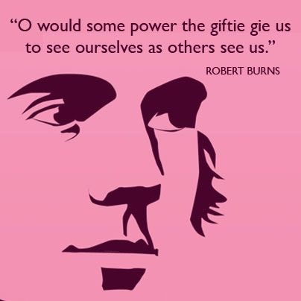

Slide 9


Slide 10
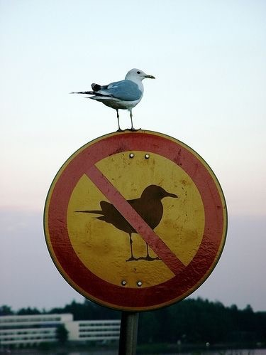

Slide 11
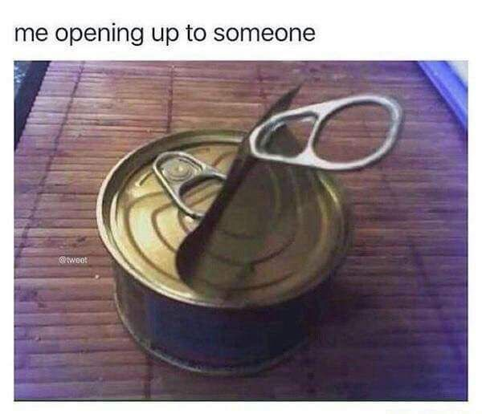

Slide 12
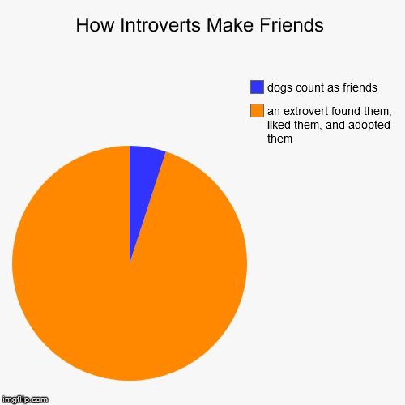

Slide 13
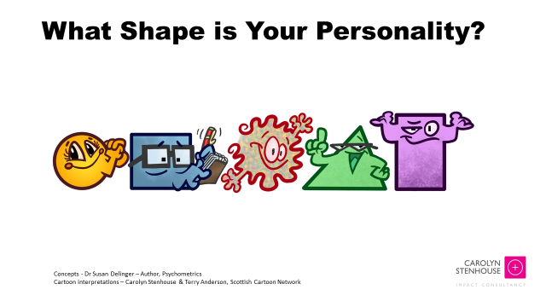

Slide 14
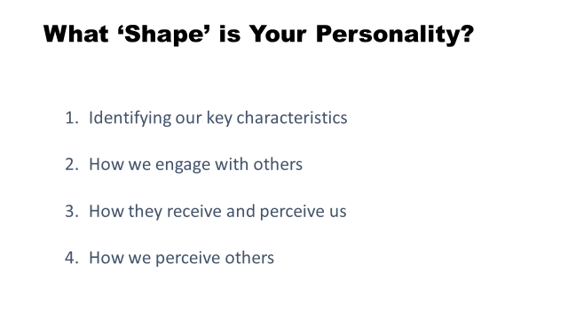

Slide 16
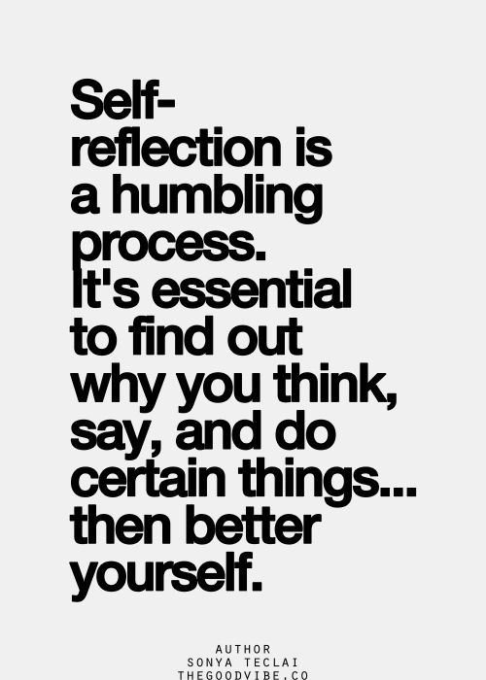

Slide 17
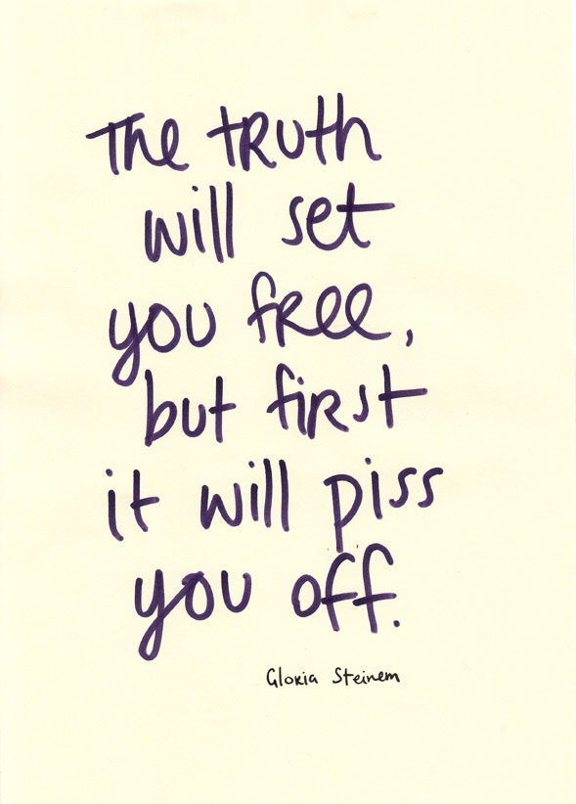

Slide 18
Great people
Who’re really great with people
Know all about…….

Slide 19
Shit
Throwers
Receivers
Dodgers

Slide 20
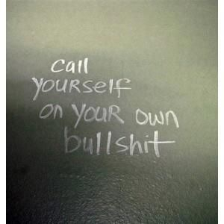

Slide 21


Slide 22

  The games that people play….
  The psychological processes at play
  in our transactions with others

Slide 23
The ‘game’
Persecutor
F.U.
Rescuer
‘I’ll do it for you’
Victim
‘Poor me’
Notes:
Source: TA101 workbook, Counselling and Psychotherapy Training Institute (CPTI), Edinburgh.
See explanation at:
http://en.wikipedia.org/wiki/Karpman_drama_triangle

Slide 24
People won’t remember what you said,
they’ll remember how you made them feel. Maya Angelou

Slide 25


Slide 26


Slide 27
Our Relational Needs
1 | Security
2 | Significance (incl seen and heard)
3 | Acceptance
4 | Mutuality
5 | Uniqueness
6 | Impact
7 | Contact
8 | Caring
Source: Richard G. Erskine and Rebecca Trautmann, with web analysis by Lindsay Stewart, adapted by Carolyn Stenhouse

Slide 28
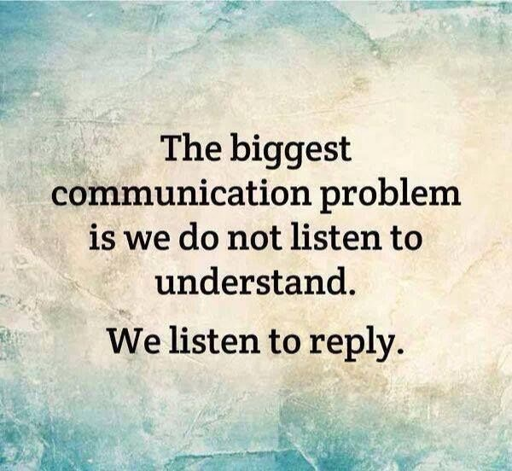

Slide 29
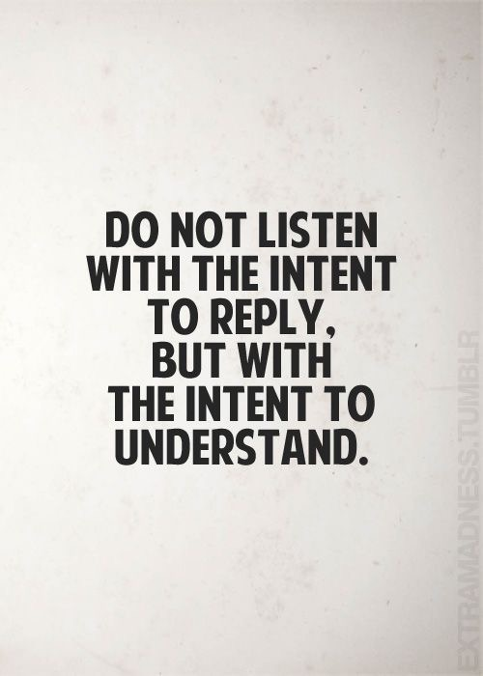

Slide 30
Relationship Questions
Do you want to talk? I’m here and keen to listen
I’m interested in what’s going on for you – help me understand
What is important to you about that?
What are you feeling? Has something been triggered?
Do you think there might be something else going on? (unidentified need)
How can I help? What do you need? (Think relational needs)
What’s my part in this (asked to them and to self)?

Slide 31
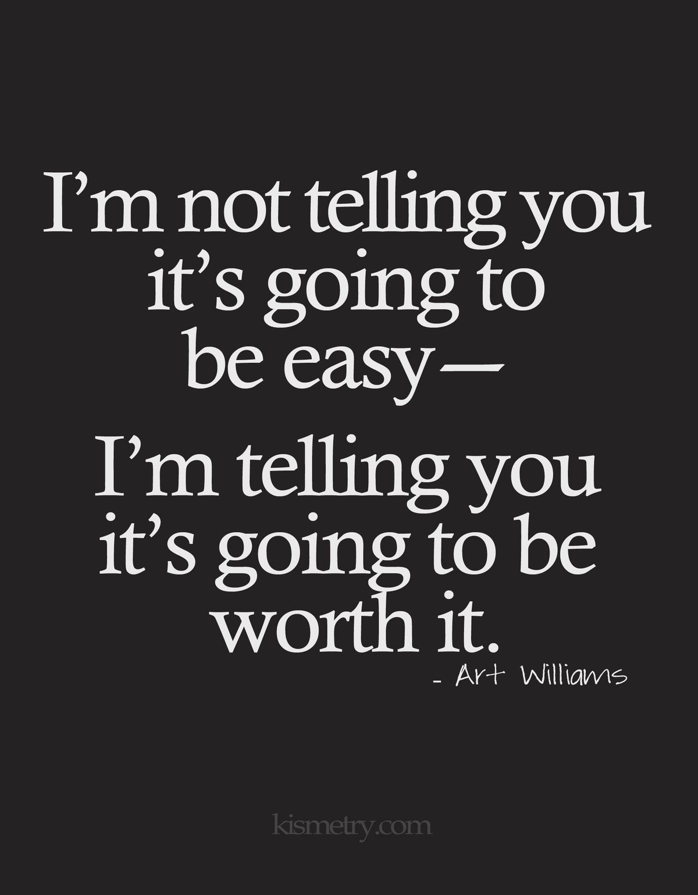

Slide 32
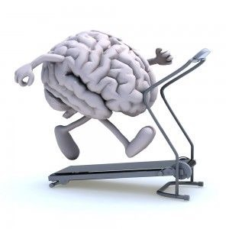
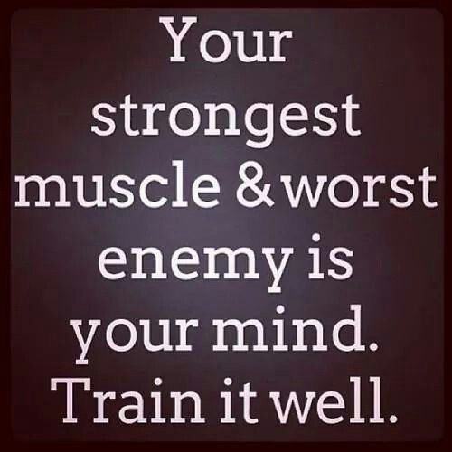

Slide 33
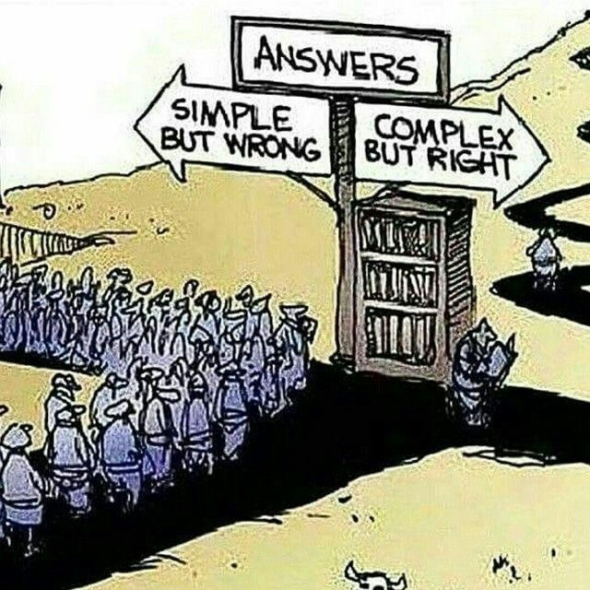

Slide 34


Slide 35


Slide 36


Slide 37
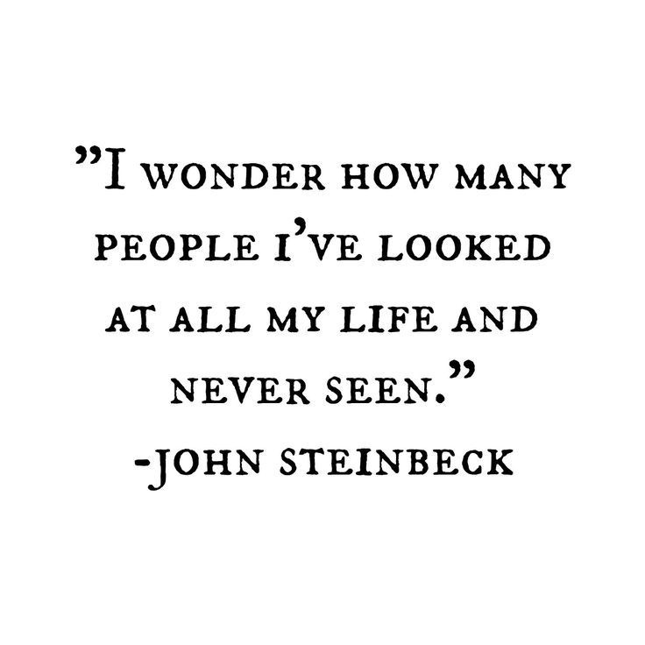

Slide 38
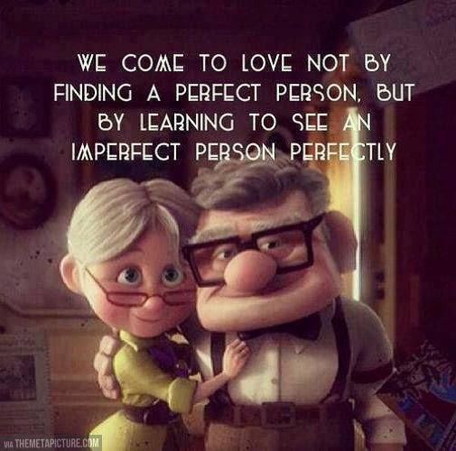

Slide 39
carolynstenhouse.com

Slide 40
OK Corral
I’m OK | You’re OK
Yup | Yup
Yup | Nope
Nope | Nope
Nope | Yup

